Slide 1
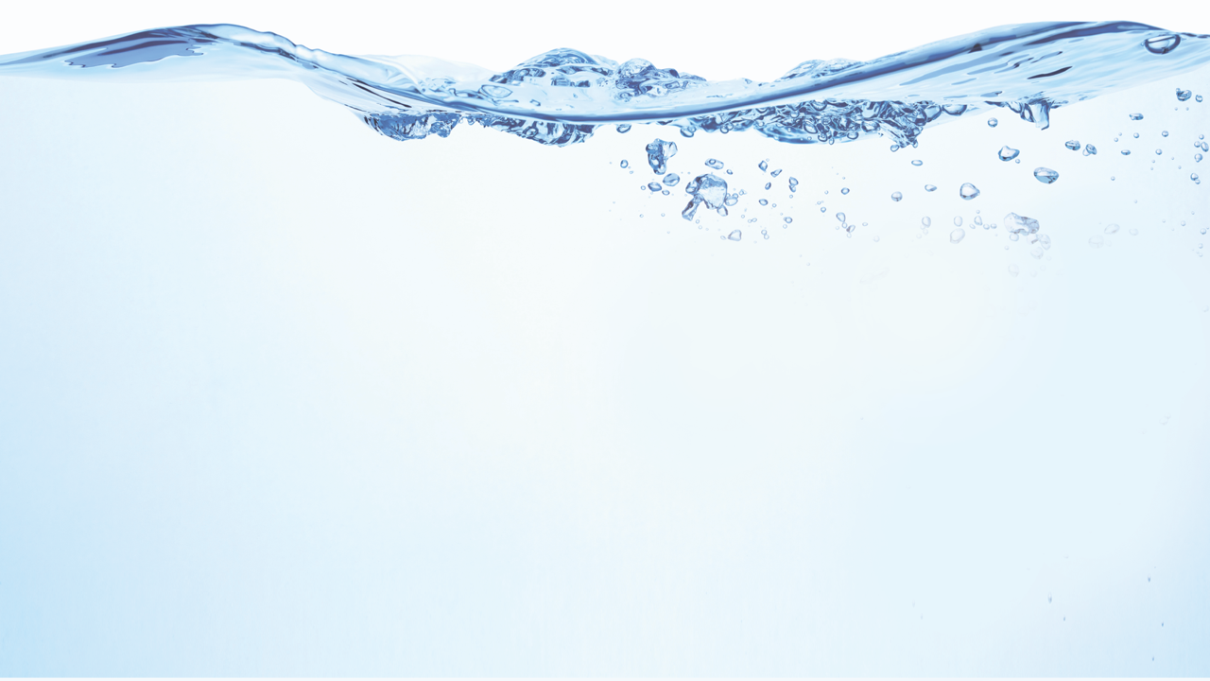

National Source Water Collaborative
Bipartisan Infrastructure Law (BIL) Webinar Series

Slide 2

Agenda
National Source Water Collaborative
Sylvia Malm, Ground Water Protection Council (GWPC)
Welcome and Introduction to Source Water Collaborative
James Capurso, USDA Forest Service
Forests and Water Partnership and Projects:
The Drinking Water Providers Partnership
Shasta Ferranto, USDA Forest Service
Wildfire Crisis, Pacific Northwest Region
Matt Piccarello, Rio Grande Water Fund and
The Nature Conservancy
The Rio Grande Water Fund: Adapting to meet the moment
Julie Harvey, Oregon DEQ
Drinking Water Protection – Watershed Management
State Source Water Program Perspective
Kathy Hawes, Southeastern Partnership for Forests and Water
Question & Answer; Final Reflections
Bipartisan Infrastructure
Law (BIL) Webinar Series

Slide 3




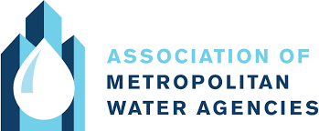

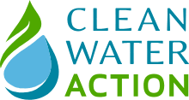
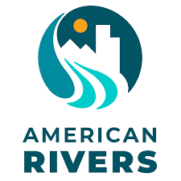

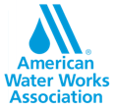

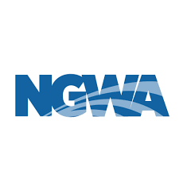

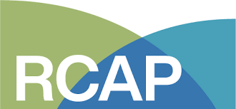


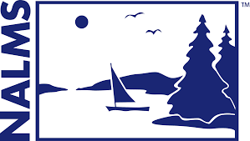




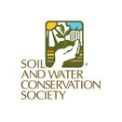




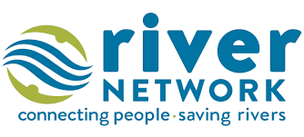
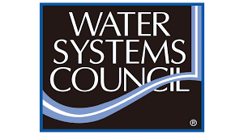

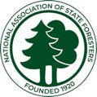

National Source Water Collaborative
30 national organizations uniting to protect America’s drinking water at the source​
Combine strengths & tools of diverse member orgs to protect drinking water sources for generations ​
Leverage resources, identify synergy, sharing tools and information, supporting local collaboratives​

Slide 4


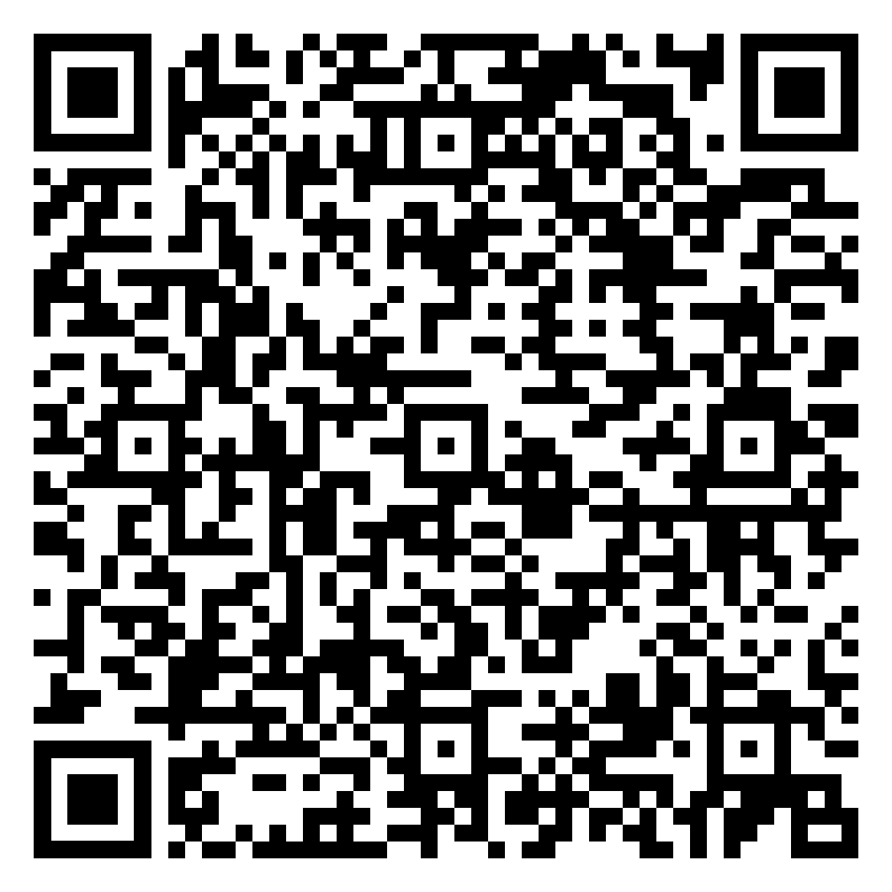
BIL Learning Exchange
Addressing Emerging Contaminants in Source Water Using BIL Grants and Forgivable Loans
Recording
Available Online
Demystifying How to Access BIL Funds for Source Water Protection and Natural Infrastructure
Recording
Available Online
Presented by:
Leveraging U.S. Forest Service BIL Funds for SWP on Forested Lands
Today’s webinar
BIL Funding for Disadvantaged Communities for Drinking Water & Environmental Justice
May 30th
Register Now

Slide 5
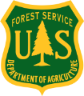
Forests and Water Partnership and Projects:
The Drinking Water Providers Partnership
The Source Water Collaborative
Bipartisan Infrastructure Law Learning Exchange Webinar Series
April 22, 2024
James Capurso, PhD
Pacific Northwest Regional Fisheries Biologist
USDA Forest Service

Slide 6
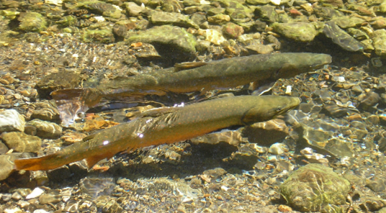
Content
Introduction to two potential aquatic restoration funding sources:
  Bipartisan Infrastructure Law
  Inflation Reduction Act
Drinking Water Providers Partnership

Slide 7
Two Potential Funding sources

Slide 8
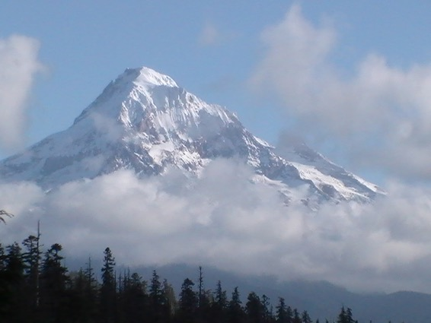
Bipartisan Infrastructure Law
Signed into law by President Biden November 2021 to invest in the nation’s infrastructure and competitiveness.
The law provides the USDA Forest Service $5.5 Billion over 5 years to:
  Reduce wildland fire risk
  Improve wildland fire management
  Invest in wildland firefighters.
  Restore ecosystems and watersheds
  Repair infrastructure, especially roads, trails, and recreation-related.

Slide 9
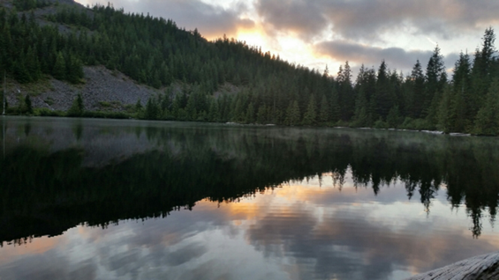
Bipartisan Infrastructure Law
BIL funding includes:
  $25.5 Million over 5 years for Collaborative Aquatic Landscape Restoration Program
  approximately $40 Million per year for Legacy Roads and Trails Program
  $100M per year for invasive species management.
  Pre- ($3.5B) or Post-Fire ($100M) funding for watershed resilience.

Slide 10
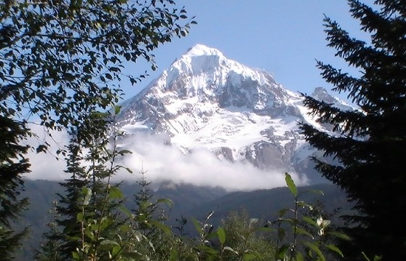
Inflation Reduction Act
Signed into law by President Biden August 2022 to curb inflation while addressing climate change, jobs, health care, energy security, etc.
Provided the USDA Forest Service $5 Billion over 9 years for:
  fuels and forest health treatments to protect communities from wildfire
  competitive grants to non-Federal forest landowners
  State and Private Forestry programs
  administrative costs for implementation.

Slide 11
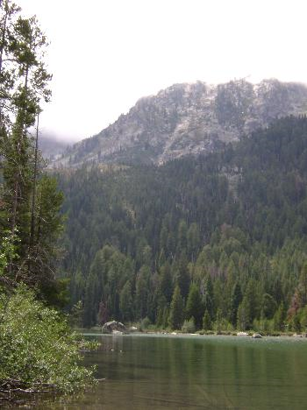
Inflation Reduction Act
IRA funding includes $200M for vegetation and watershed management
  Funding used for source water protection:
    Capacity building
    Planning
    Implementation
  Requirements:
    Must be on NFS lands
    Project must be carried out in accordance with either a:
      Watershed Condition Framework Watershed Restoration Action Plan
      Water Source Management Plan

Slide 12
Drinking water providers partnership

Slide 13
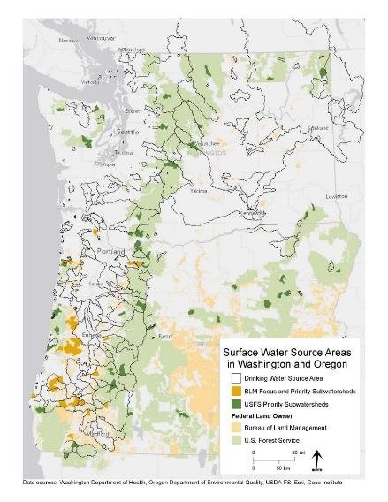
Municipal Watersheds in the Pacific Northwest
50% of water used in the Western U.S. originates from National Forests
65% of Oregonians (ODEQ 2016) and 40% of Washingtonians (DOE 2016) rely primarily upon surface water for their drinking water sources.

Slide 14
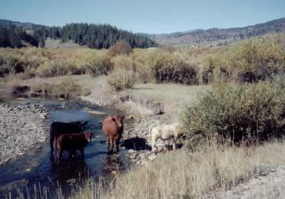
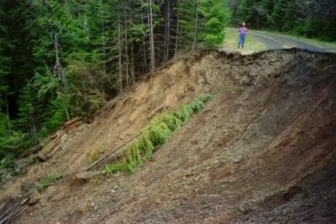
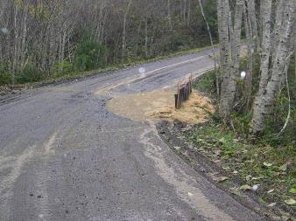
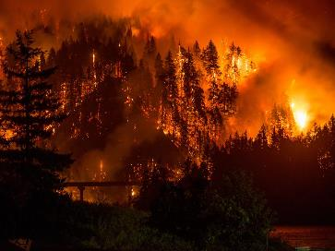
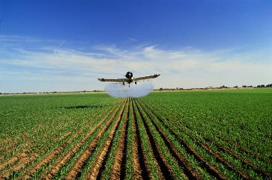
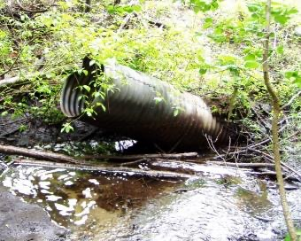
Challenge to Protect Municipal Watersheds

Slide 15
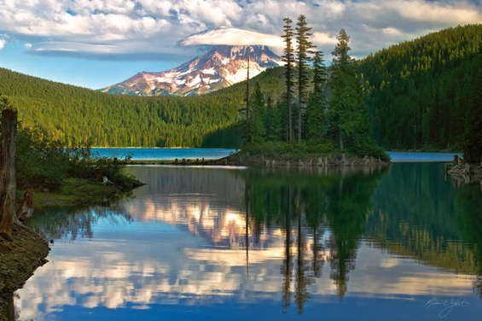
Challenge to Protect Municipal Watersheds
  The Safe Drinking Water Act does not provide regulatory authority for communities to protect their drinking water
  Few towns own their source watershed
  Primarily just larger towns and cities have capacity to protect or restore source watersheds

Slide 16
PARTNERSHIP ORIGIN

Slide 17
Partnership Origin
Clean, Inexpensive Drinking Water
Municipal Watershed Restoration
In 2014, Geos Institute and the PNW Region of the Forest Service set out to develop a municipal watershed-focused partnership.
The intent was to identify, implement, and monitor watershed restoration within municipal watersheds:
  Benefiting watershed/fisheries resources
  Protecting and restoring water quality and quantity
  Decreasing water treatment costs.

Slide 18
Partnership Origin
Water Providers
Land Managers
Restoration Practitioners
The Forest Service and GEOS developed a concept to establish a partnership bringing together:
  Water providers wanting to improve their source watersheds (but lacking resources or capacity)
  Restoration Practitioners having the expertise and capacity to restore watersheds
  Land managers managing land within municipal watersheds

Slide 19
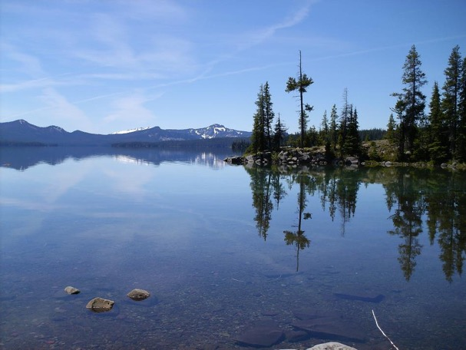
Partnership Origin
In 2014, FS and GEOS introduced the partnership concept to municipal water providers.
The idea was met with great support
We began to introduce water providers to local restoration practitioners
We heard clearly from the local partners a source of funding was needed for project implementation.

Slide 20

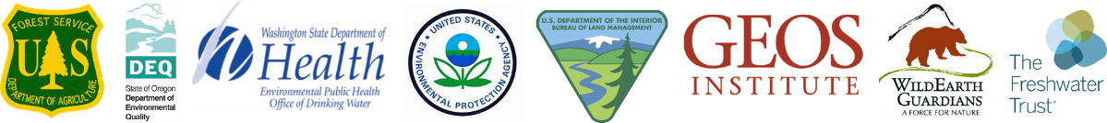
Partnership Origin
In 2015, a regional partnership officially formed in response to the grassroots partnerships’ request for a funding source
Oregon Department of Environmental Quality, Washington Department of Health, Environmental Protection Agency, Bureau of Land Management, and Wild Earth Guardians joined and pooled financial and in-kind resources in 2015
The Freshwater Trust joined in 2018

Slide 21
Drinking Water Providers Partnership Goals
Restore and protect the health of watersheds communities depend upon for drinking water while also benefiting aquatic and riparian ecosystems, including the native fish that inhabit them.
Encourage and support local partnerships between water providers and restoration practitioners.

Slide 22
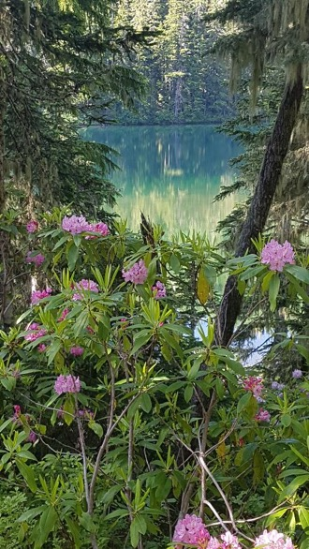
Geographic Eligibility
Anyone can apply for funds
Projects located in a public drinking water watershed in Oregon or Washington.
For best consideration, projects should be:
  in or near a USFS priority watershed.
  in or near a BLM priority watershed.
  in Oregon, be in a sensitive area identified in an updated source water assessment delineation.

Slide 23
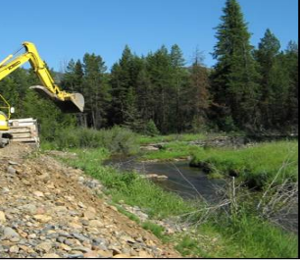
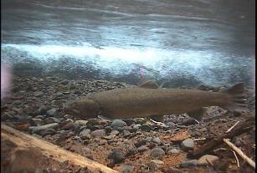
DWPP Project Types
Activities may include feasibility analyses, planning, design, outreach, education, and monitoring.
Work addresses water quality or quantity issues within a public drinking water system, benefiting native fish and their habitat.

Slide 24
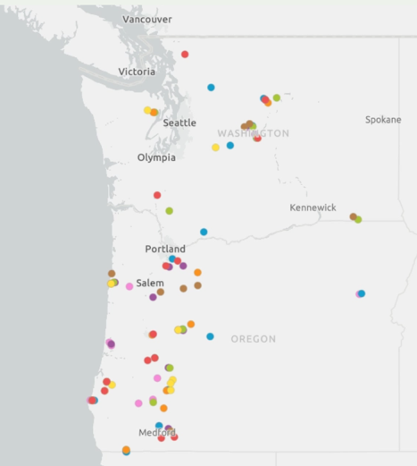
DWPP Restoration Investments
The partnership is 8 years old.
During that time, we invested in 118 projects
We invested approximately $6M in partner funds.

Slide 25
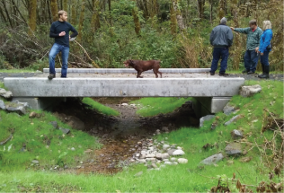
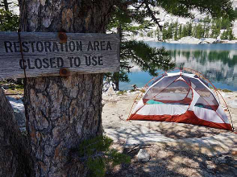
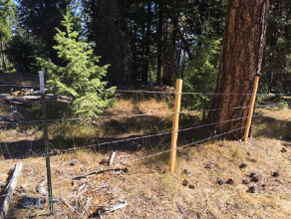
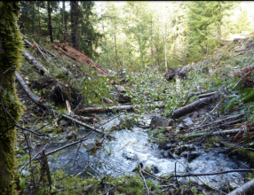
TYPICAL DWPP PROJECTS
We fixed a migration barrier at Grant Ck for the Town of Glide, Or
We educated campers at Icicle Ck for the town of Leavenworth, Wa
We excluded livestock from the Baker City, Or municipal watershed
We removed a road crossing barrier from the North Umpqua River for the town of Glide, Or

Slide 26
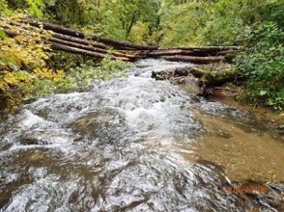
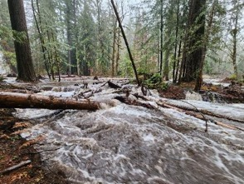
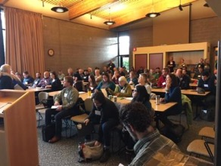
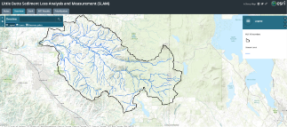
TYPICAL DWPP PROJECTS
We developed a sediment reduction project prioritization model for Medford, Or
We added large wood to Rickreal Creek for the City of Dallas, Or
We restored the valley bottom elevation to return streamflow to floodplains in Deer Creek, South Fork McKenzie River, and McKenzie River for the City of Eugene, Or.
We continue to host workshops connecting drinking water providers with restoration practitioners and funding sources throughout Oregon and Washington

Slide 27
For More Information:
https://geosinstitute.org/initiatives/dwpp/
James Capurso, PhD
Regional Fisheries Biologist
Pacific Northwest Region
USDA Forest Service
jcapurso@usda.gov
Tonya Graham, Working Waters Director, Geos Institute, tonya@geosinstitute.org
Dan Brown, Environmental Review and Sediment Manager, EPA, brown.dan@epa.gov
Emily Johnson, Oregon Fisheries Lead, BLM, ekjohnson@blm.gov
Mike Brown, Oregon Hydrologist Lead, BLM, mebrown@blm.gov
Julie Harvey, Drinking Water Protection Coordinator, ODEQ, Julie.Harvey@deq.state.or.us
Nikki Guillot, Source Water Protection Manager, Washington Dept of Health, Nikki.Guillot@doh.wa.gov
Ryan Talbott, PNW Conservation Manager, WildEarth Guardians, rtalbott@wildearthguardians.org
Mark McCollister, Habitat Restoration Director, The Freshwater Trust, mark@thefreshwatertrust.org

Slide 28
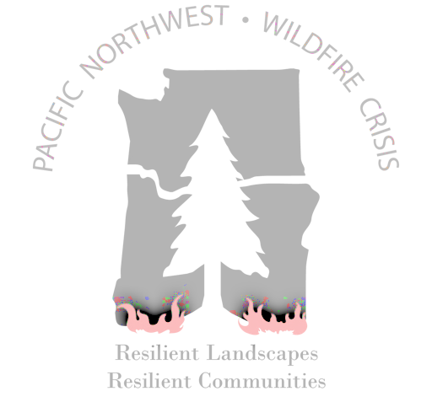

Slide 29
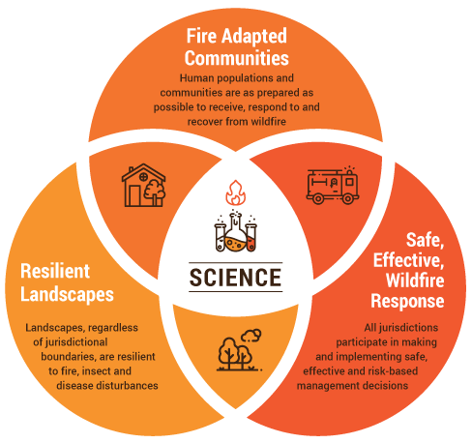
Cohesive Wildland
Fire Strategy
April 2014
https://www.forestsandrangelands.gov/strategy/

Slide 30
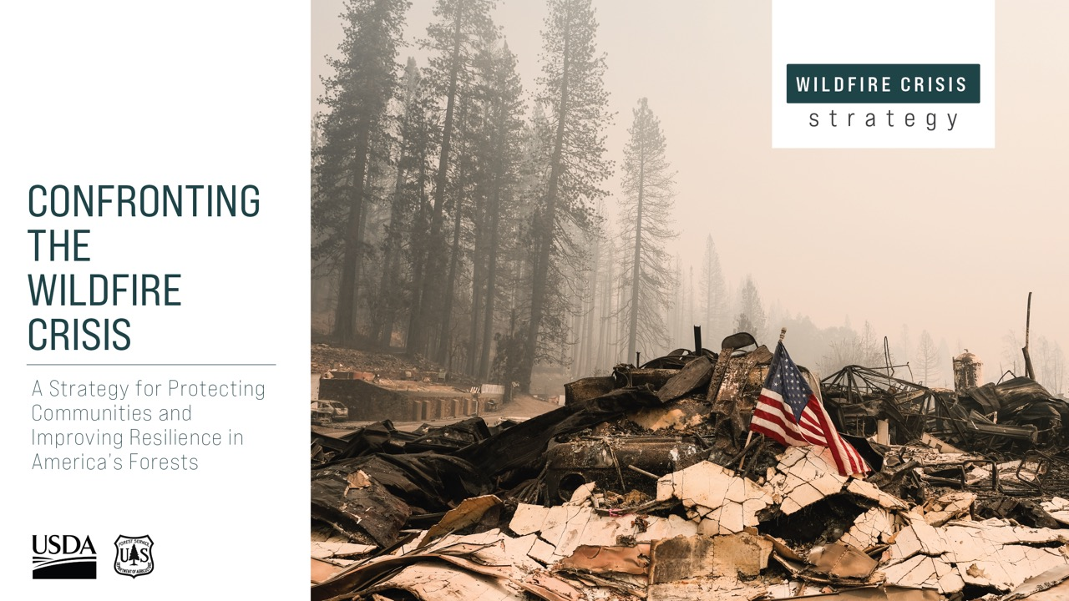
https://www.fs.usda.gov/managing-land/wildfire-crisis

Slide 31





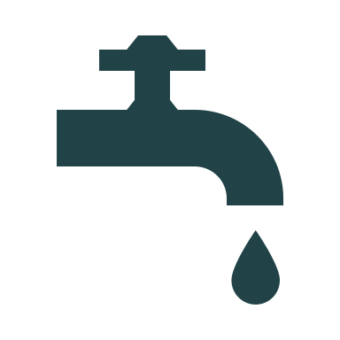


Fire risk to what?
Old growth
Infrastructure
Wildlife habitat
Timber
Agriculture
Drinking water
Recreation
People & Property

Slide 32

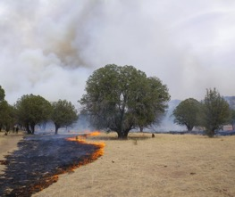
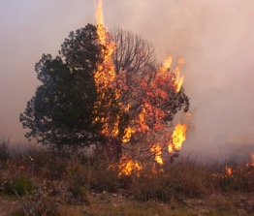
QUANTITATIVE WILDFIRE RISK ASSESSMENT
Assesses overall fire risk on the landscape
What values are at risk to fire
How are these values affected by different intensity fire
How likely is fire to occur and at what intensity?
QUANTITATIVE WILDFIRE RISK ASSESSMENT
Assesses overall fire risk on the landscape impacting values on all lands.

Slide 33
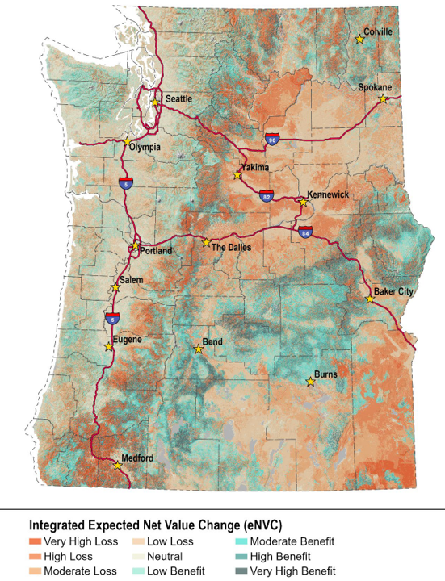
Pacific Northwest qwRA
https://wildfireriskpnw.forestry.oregonstate.edu/
For more information contact:
wildfireriskpnw@gmail.com

Slide 34
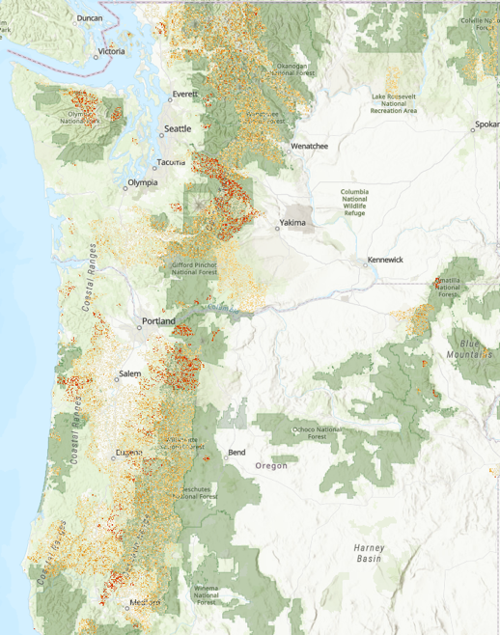
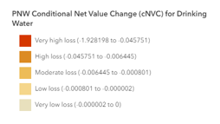
Drinking Water
Pacific Northwest qwRA

Slide 35
Drinking Water
Pacific Northwest qwRA

Slide 36

Drinking water
Pacific Northwest qwRA

Slide 37

Wildfire Crisis Investments
$1.4 BILLION
BIPARTISAN INFRASTRUCTURE LAW Reducing fuels like dead trees, dense vegetation, and other hazardous fuels
  $1.8 BILLION
  INFLATION REDUCTION ACT
  Focused on wildfire risk reduction in the Wildland Urban Interface (WUI)

Slide 38






Prioritize wildfire risk reduction Projects…
in the wildland-urban interface (WUI)
public drinking water source areas
areas strategically important for reducing risk
that retain large trees in fire-resilient stands
that maintain or restore old growth stands
Restricted to National Forest System

Slide 39

What success looks like
COMMUNITY RISK &
SAFETY
ECOSYSTEM VALUES & RESILIENCE
Reduce wildfire transmission from national forests and grasslands
Support municipal water supply
Improve suppression effectiveness and reduce firefighter exposure
Increase landscape resiliency
Support key ecosystem values
Protect local values
Reduce compounding stressors and risks (climate, insects & disease)

Slide 40

Wildfire Crisis Landscapes

Slide 41
Fy22 to FY24 Investments (Millions of Dollars)
Program | WA | OR
BIL/IRA National Forests | 82 | 88
Collaborative Forest Landscape Restoration Program (CFLRP) | 18 | 37
Base Fuels Program | 20 | 31
Joint Chiefs | 0 | 27
Community Wildfire Defense Grants | 24 | 24
Disaster Supplemental Fuels | <1 | 7
Tribal Forest Protection Act (TFPA) | 1 | 3
Good Neighbor Agreement (GNA) | 15 | 3
National Fire Capacity Grants | 6 | 2
BIL Grants to State | 1 | 1
Post-Fire Recovery | 18 | 298
TOTAL | $184 | $522

Slide 42

Community Wildfire Defense Grants
Total Available: $1 Billion
Awarded in FY23: $200 Million
https://www.fs.usda.gov/managing-land/fire/grants

Slide 43

Who Can Apply for CWDG?
Entities eligible to apply as at-risk
communities include:
Units of local governments representing communities located in an area with a risk of wildfires
State forestry agencies
Indian Tribes and Alaska Native Corporations
Non-profit organizations that assist at-risk communities
https://www.fs.usda.gov/managing-land/fire/grants

Slide 44

Joint Chiefs Landscape restoration partnership
Partnership created between USFS and NRCS in 2014
Codified under BIL
Yearly request for proposals
3 years of funding
Tongass NF: Prince of Wales Landscape Restoration Partnership
https://www.nrcs.usda.gov/programs-initiatives/joint-chiefs-landscape-restoration-partnership

Slide 45

Joint Chiefs Landscape restoration partnership
~$48 million awarded annually
Millions
https://www.nrcs.usda.gov/programs-initiatives/joint-chiefs-landscape-restoration-partnership

Slide 46
Joint Chiefs Landscape restoration partnership
BEST PRACTICES
Scale appropriate to challenge
Locally led, local coordination
Strong partnerships
Built-in flexibility to changing conditions
Millions
https://www.nrcs.usda.gov/programs-initiatives/joint-chiefs-landscape-restoration-partnership

Slide 47





Collaborative Forest Landscape Restoration Program
Created by Law in 2009 to:
  Encourage collaborative, science-based restoration on priority landscapes
  Support ecological, economic, and social outcomes
  Reduce wildfire risk
  Achieve ecological and watershed health
  Use wood byproducts to benefit economies
  Leverage public and private resources
https://www.fs.usda.gov/restoration/CFLRP/

Slide 48


Collaborative Forest Landscape Restoration Program
Act authorizes funding for implementation and monitoring
CFLRP funding can be spent on National Forest System lands
Funds can be used to cover up to 50% of the costs
Each project can receive no more than $4 million per year
Remainder of costs through matching funds (other FS dollars, partner contributions, goods for services)
https://www.fs.usda.gov/restoration/CFLRP/

Slide 49

Collaborative Forest Landscape Restoration Program
~$30 million awarded annually
Millions
Regional Contacts: https://www.fs.usda.gov/restoration/CFLRP/overview.shtml

Slide 50
Collaborative Forest Landscape Restoration Program
BEST PRACTICES
Use of spatial planning tools
Strong community outreach and education
Collaborative involvement & implementation
Long-term 5-10 years plans and mixed program of work
Prioritizing resources

Slide 51

Community Navigators
Partners
Coalitions and Collaboratives Inc
First Nations Development Institute
Hispanic Access Foundation
The Federation of Southern Cooperatives
The Watershed Research and Training Center
https://www.fs.usda.gov/working-with-us/navigators
sm.fs.Navigators@usda.gov

Slide 52

Shasta Ferranto
Regional Wildfire Crisis Coordinator
Assistant Director, Fire, Fuels & Aviation
Pacific Northwest Region
Shasta.Ferranto@usda.gov

Slide 53


The Rio Grande Water Fund: Adapting to meet the moment
Matt Piccarello, Forest and Watershed Health Manager
The Nature Conservancy
Photo: Alan W Eckert

Slide 54


Which is a picture of infrastructure?
Credit: William Melhado

Slide 55


Where we started
Credit: Jim Weber
Las Conchas Wildfire 2011 – 156,000ac
Hermits Peak/Calf Canyon Wildfire 2022 – 341,471ac

Slide 56


“The Rio Grande Water Fund invests in the restoration of forested lands upstream so we can secure pure fresh water. Our goal is to generate sustainable funding over the next 20 years to proactively increase the pace and scale of forest restoration, including the most high-risk areas in the Rio Grande watershed. This innovative project offers a solution that can bring clean water and outdoor opportunities to New Mexicans for generations to come.”
Credit: Craig Allen

Slide 57


Slide 58


Priority treatment areas
Modeled treatment effectiveness

Slide 59
The Moment
Infrastructure Investment and Jobs Act (IIJA/BIL)
$3.5B for wildfire risk reduction
$2B for ecosystem restoration (fish passage, invasive species, mined lands, revegetation, etc)
Inflation Reduction Act
$2.1B for NFS ($1.8B for haz fuels)
$1.5B for urban & community forestry
Context
Forest and Watershed Restoration Act (FAWRA)
$2M in 2019
$3.2M in FY25
$12M invested in haz fuels on NFS Lands – 2014 Comprehensive plan
  $11.8M year one/five of Community Wildfire Defense Grant funds in NM (non-federal lands)
  $11.3M FY22-24 investments in Enchanted Circle Priority Landscape Alone
Land of Enchantment Legacy Fund
$50M initial investment
https://iratracker.org | https://www.tenstrategies.net/newfederalfunding

Slide 60

Wildfire Crisis Strategy
    Jan 2022, Forest Service launched 10-year strategy to address wildfire crisis where it poses most immediate threats to communities
    Initial 10 landscapes announced in 2022, additional 11 landscapes announced in 2023 – 134 of 250 high risk firesheds in West
    Leverages suite of provisions to move quickly and effectively
    https://www.fs.usda.gov/managing-land/wildfire-crisis

Slide 61



Source water funders
Albuquerque Bernalillo County Water Utility Authority
General Mills Foundation
Middle Rio Grande Conservancy District

Slide 62
Community Wildfire Defense Grant Program
Program details
Eligible lands
Develop and revise Community Wildfire Protection Plans (CWPP).
Implement projects described in a Community Wildfire Protection Plan – or FEMA approved Hazard Mitigation Plan – that is less than ten years old.
Up to $10 million per award
Private lands
Local governments
Homeowner associations
State government
Tribal/Alaska native corporation (includes Trust lands)
https://www.fs.usda.gov/managing-land/fire/grants

Slide 63
Important details
All or nothing points
Low-income community (0 or 10 points)
Affected by a severe disaster (0 or 10 points)
High/very high wildfire hazard potential (0 or 20 points)

Slide 64


https://www.wildfirereadywatersheds.com/

Slide 65
Questions?
Contact
Resources
Matt Piccarello
Forest and Watershed Health Manager
The Nature Conservancy, NM
m.piccarello@tnc.org
505-470-9725
https://iratracker.org
www.tenstrategies.net/newfederalfunding
https://iijatracker.substack.com/
https://www.conservationfinancenetwork.org/
https://www.nature.org/en-us/about-us/where-we-work/united-states/new-mexico/stories-in-new-mexico/new-mexico-rio-grande-water-fund/
https://resilientwatersheds.nature.org/
https://nature4water.org/

Slide 66


State Source Water Program Perspective
Julie Harvey Oregon DEQ
Drinking Water Protection Program Coordinator
julie.harvey@deq.oregon.gov
http://www.oregon.gov/deq/wq/programs/Pages/DWP.aspx
  22, 2024 – Source Water Collaborative Webinar
Julie Harvey | Oregon Department of Environmental Quality

Slide 67

USFS in Oregon
USFS lands cover 33% of our Drinking Water Source Areas for water systems served by surface water.
If we also include BLM lands, Federal lands comprise 43% of our SW DWSAs.
Also intersect groundwater source areas.
      https://www.oregon.gov/deq/wq/programs/Pages/DWP-Maps.aspx

Slide 68

Next Steps: Connect with Partners
State Department of Forestry (example: Virginia) https://dof.virginia.gov/financial-assistance-programs/
National Association of State Foresters (NASF) https://www.stateforesters.org/
                Each state has a “Forest Action Plan” which can be found via the NASF website
            Drinking Water Providers Partnership https://geosinstitute.org/initiatives/dwpp/
State Source Water Coordinators https://www.asdwa.org/sourcewatercontacts/
Source Water Contacts in EPA’s Regional Offices
    https://www.epa.gov/sourcewaterprotection/source-water-contacts-epas-regional-offices
Source Water Collaborative Webinar Series: Source Water Protection Through Forestry Partnerships
https://www.sourcewatercollaborative.org/learning-exchange/source-water-protection-through-forestry-partnerships/

Slide 69
BIL Learning Exchange
Addressing Emerging Contaminants in Source Water Using BIL Grants and Forgivable Loans
Recording
Available Online
Demystifying How to Access BIL Funds for Source Water Protection and Natural Infrastructure
Recording Available Online
Presented by:
Leveraging U.S. Forest Service BIL Funds for SWP on Forested Lands
Today’s webinar
BIL Funding for Disadvantaged Communities for Drinking Water & Environmental Justice
May 30th
Register Now

